Slide 1
iReady Mid Year Diagnostic 24-25
Show the appropriate video
Students should have ipads and headphones (individual)
Students should log in to iReady using Clever (follow directions)
(If students do not pass the practice they have to take it again and it can take a long time- I have attached answers to the practice to help support- this just gets them used to the format)
Monitor students by logging into iReady on your clever account, reports, diagnostic status. (it will say not started, in progress or completed)- change the subject on top to view math.

Slide 2
Diagnostic Video
Reading
https://videos.curriculumassociates.com/watch/JBDyY5KXMVHfaT7xJY6Qph

Slide 3
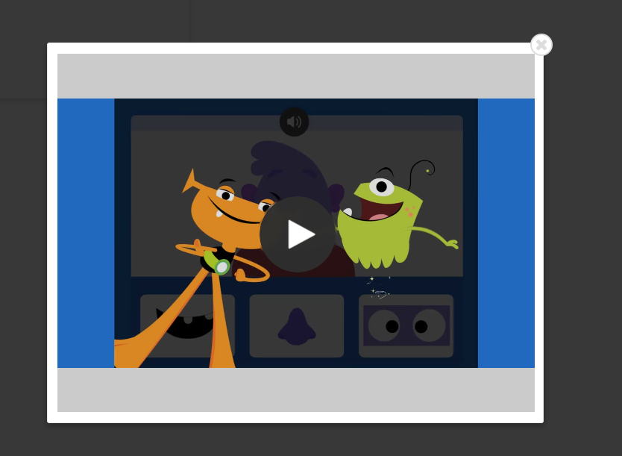
Diagnostic Video
Math
https://i-readycentral.com/videos/kindergarten-mathematics-diagnostic-introductory-video-english/

Slide 4
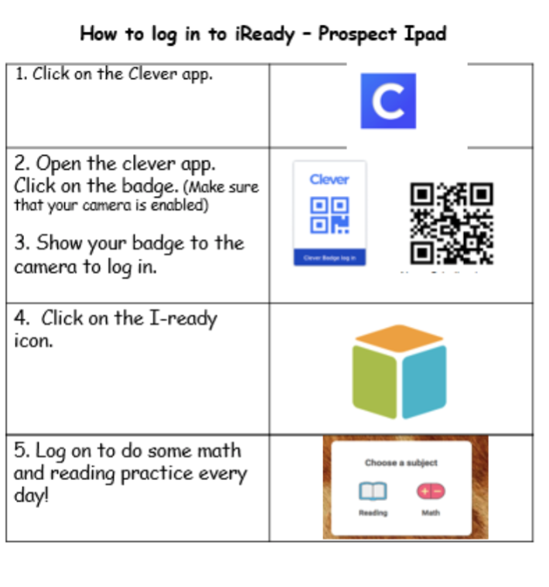

Slide 6
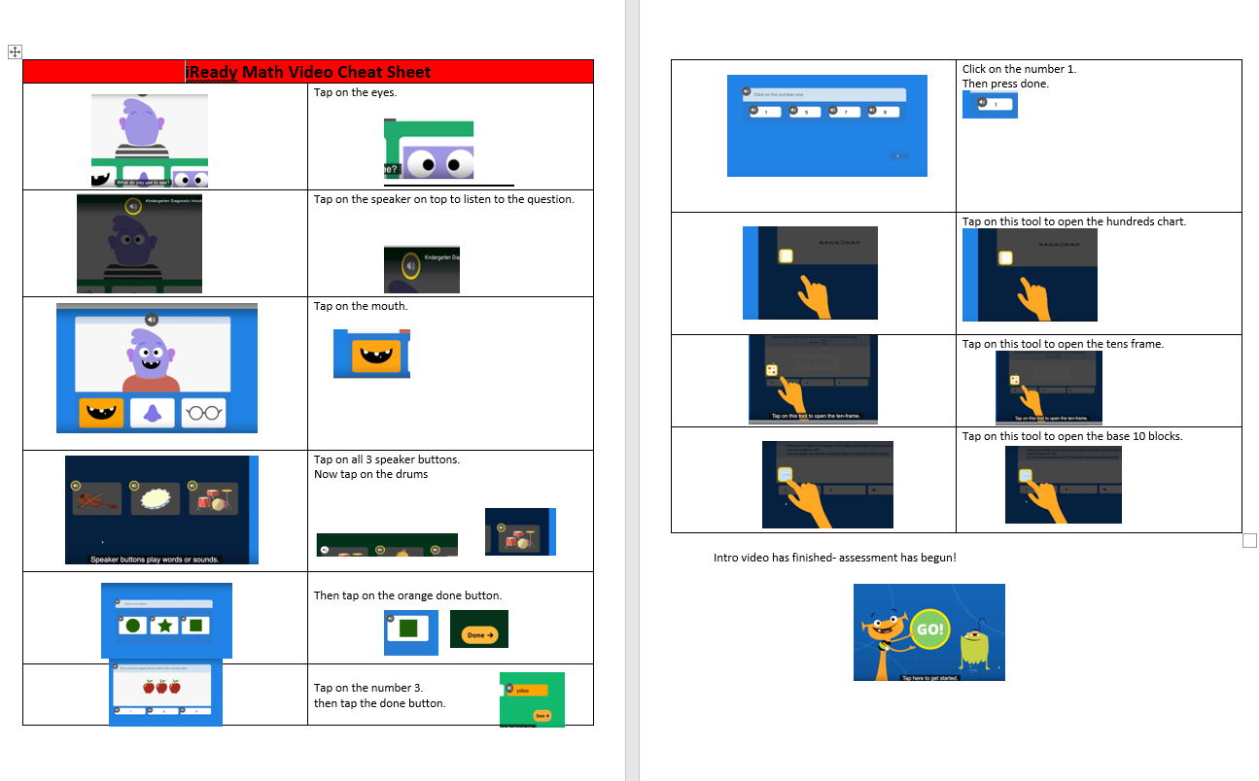

Slide 7
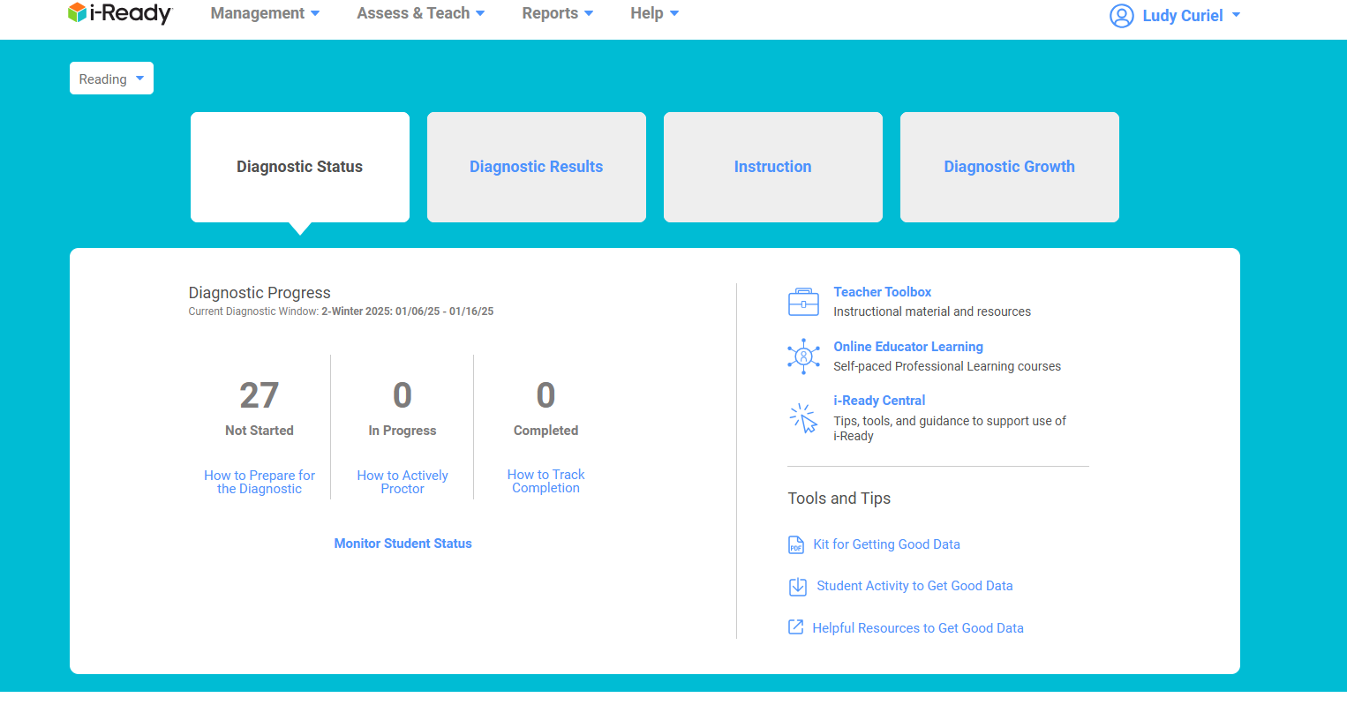

Slide 8
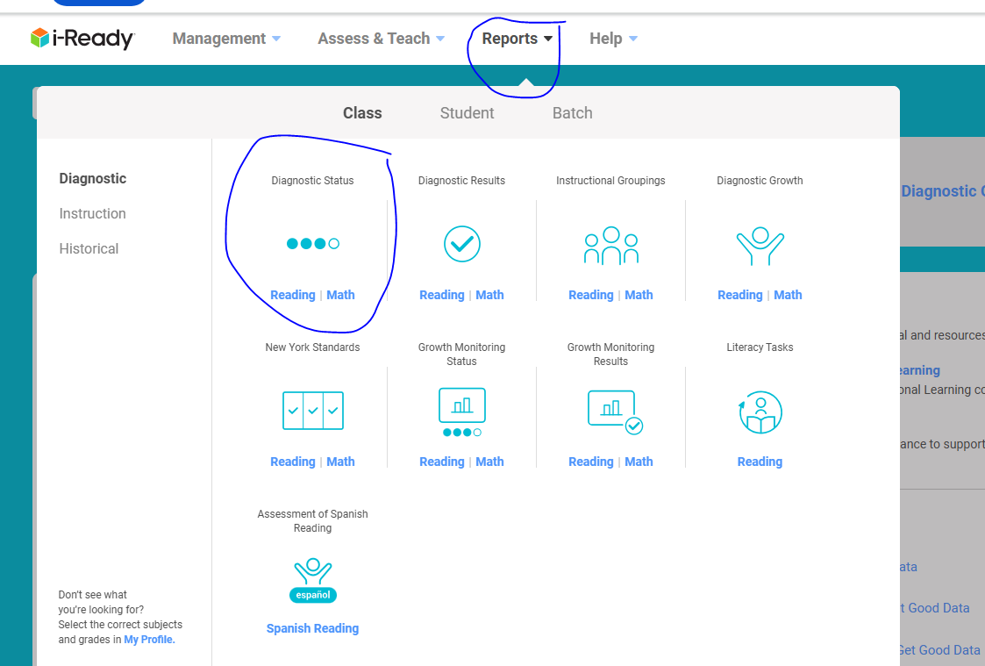

Slide 9
